Slide 1
Twitter Locality: Analyzing Communication Patterns in Social Networking
Joseph Noor
CS246
Prof. Cho

Slide 2
Motivation
2.7 Billion people on the internet ^{[1]}
Social Networking
Communicate anywhere, cheaply & quickly
What kinds of communication are actually out there?
Users, locations, distances, time
Notes:
https://www.uwsp.edu/pointeronline/Pages/articles/We-Are-the-Social-Media-Generation.aspx

Slide 3
Outline
Motivation
Random Sampling
Database Management
Assumptions
Data Analysis / Graphs
Observations
Conclusions

Slide 4
Random Communication
How to take a random sample?
Twitter Streaming API
Twitter4J ^{[2]}
Firehose vs Sample
Filter results w GeoLocation ON
Rate limiting 420
https://dev.twitter.com/discussions/27717
Notes:
Twitter API – VERY restrictive
Rate limiting bug – 420: Connection Limit Exceeded
--forgot to reset connection count even if stream stops
Retweet, Reply, Mentions

Slide 5
Database Management
Mini-twitter
Snapshot of Twitter over 1 week
JDBC + mysql
Personal machine (Macbook Pro 2012)
Naively store one-way links
Retweets, replies, mentions (@)
Always add user to database
Only use links with both users caught
Limited web crawl w/ restricted out-links
Notes:
Why I chose naivety: To maximize the amount of data I will be able to obtain within a limited time frame, I chose to store tweets in the quickest way possible. Notice that I store user location with every new user only one time in 7 days, and I don’t make sure toSN is valid when I add it (or try to waste time scraping the toSN page for a location).

Slide 6
Mini-Twitter
Stream
Sn: @realDonaldTrump
Mentions:
@lindsaylohan
@usainbolt
(realDonaldTrump, rDT_lat, rDT_lon)
tweet
Nodes
(SN, followers, lat, lon)
Links
(fromSN, toSN, time)
(realDonaldTrump, lindsaylohan, time)
(realDonaldTrump, usainbolt, time)

Slide 7
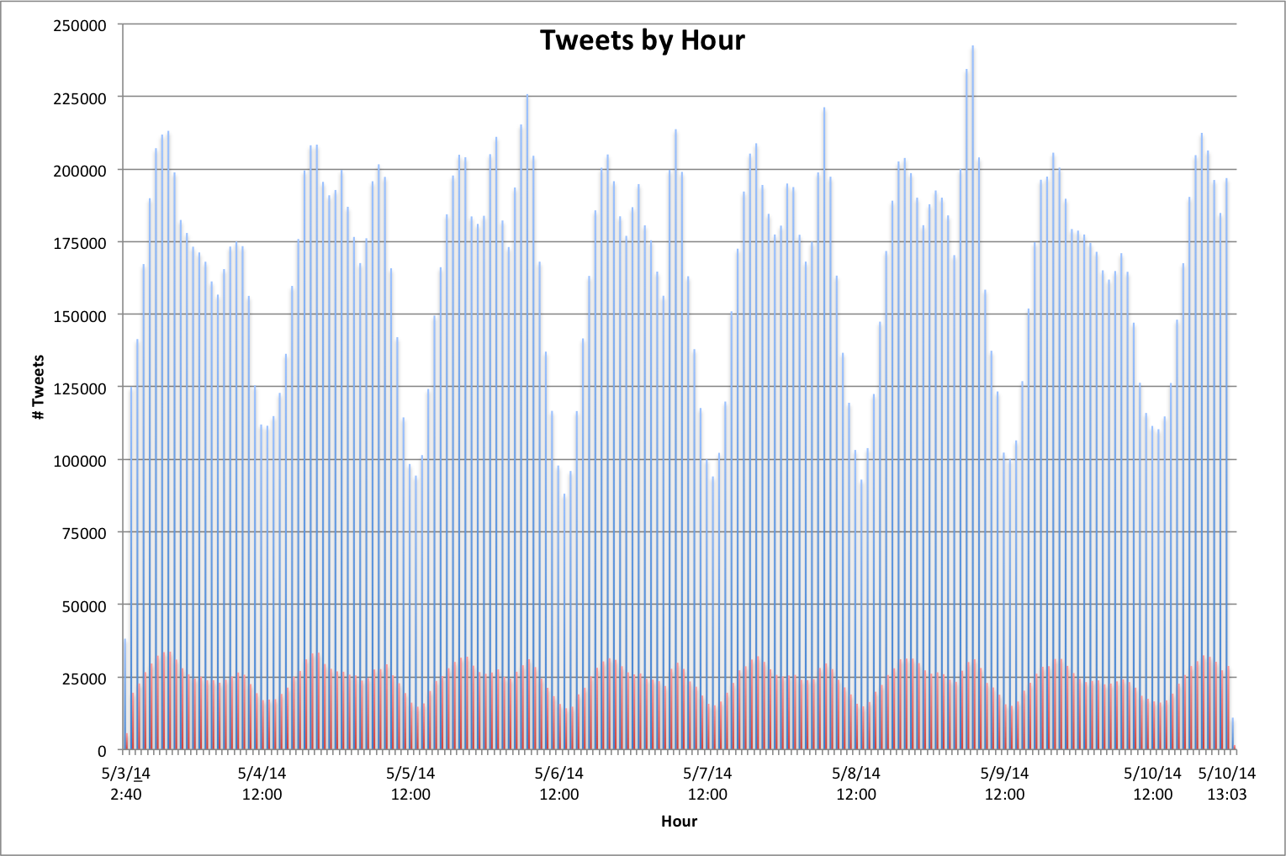
Notes:
Average of 500 million tweets per day, were getting 200k/20M => 0.5<x<1% => 15% of that
https://blog.twitter.com/2013/new-tweets-per-second-record-and-how
PST!!!
Out of 31,173,426 tweets
1,222,718 self tweets
25,528,735 with no toSN match
4,421,973 remaining

Slide 8
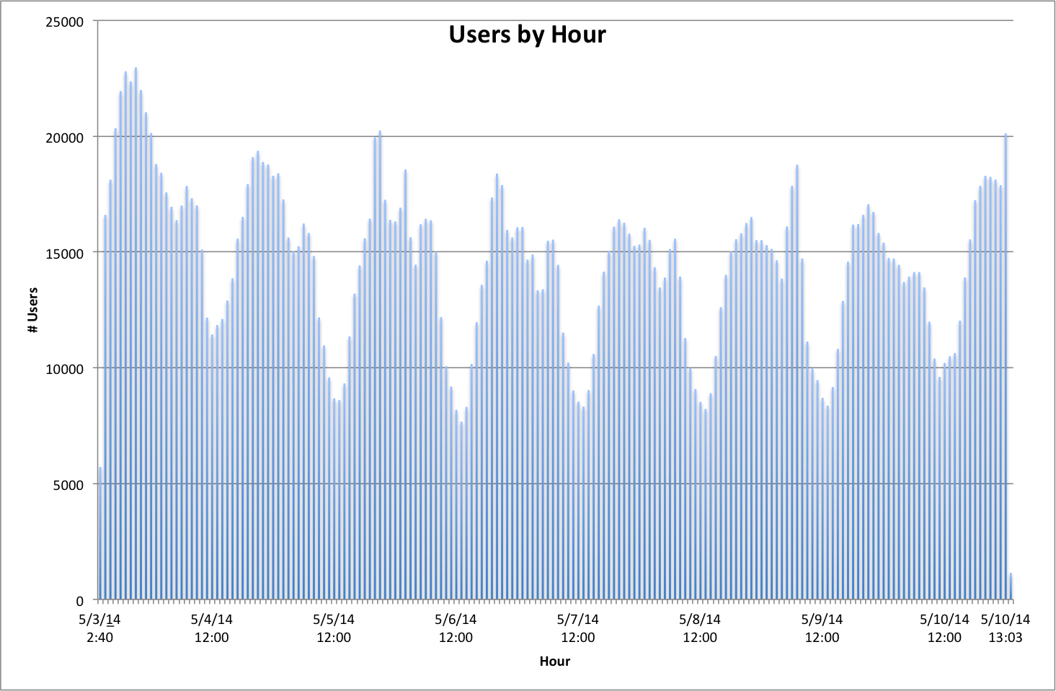
Notes:
Takeaway – for the most part, the tweets we are getting are from new users.
Lots of compulsory misses – havent made a dent in total user population => No shortage of users

Slide 9
Assumptions
Twitter Streaming API
Hidden vs Public tweets
No Correlation in GeoLocation ON/OFF
Spherical Earth Assumption ^{[3]}
“As the crow flies”
Mean Radius: 3958.75
Ideally: add elevation
Stationary User Assumption
Notes:
http://trac.osgeo.org/openlayers/wiki/GreatCircleAlgorithms
Simplifying Assumptions
ALSO – my week is representative of general communication (i.e. my week is a legitimate sample)

Slide 10
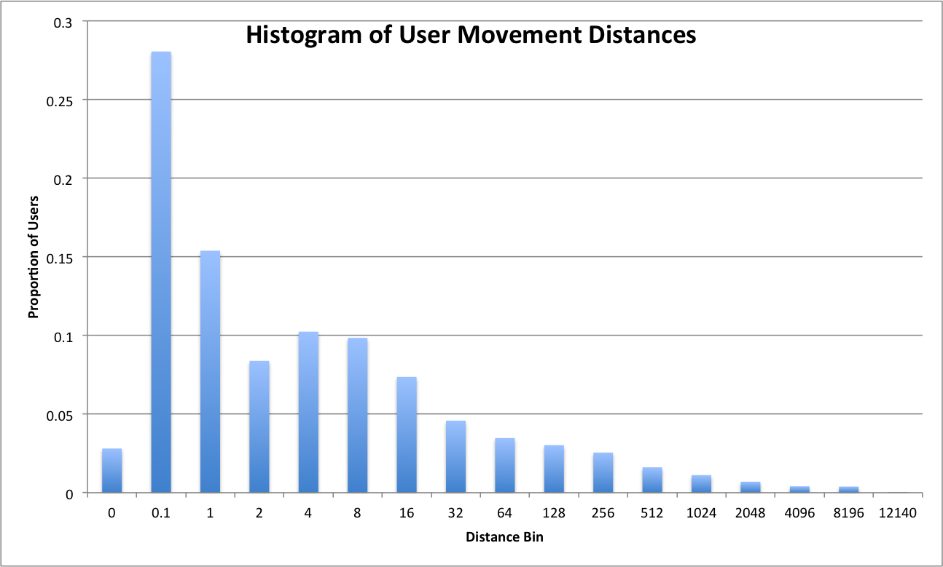
User Movement
Notes:
#Users: 6 Million from available-to-public tweets
--calculated using |T| = |B| * |S| / |B^S|
Collected users for 6 days, waited 3 days, collected users again
30% < 0.1 miles
90% of users moved <50 miles

Slide 11
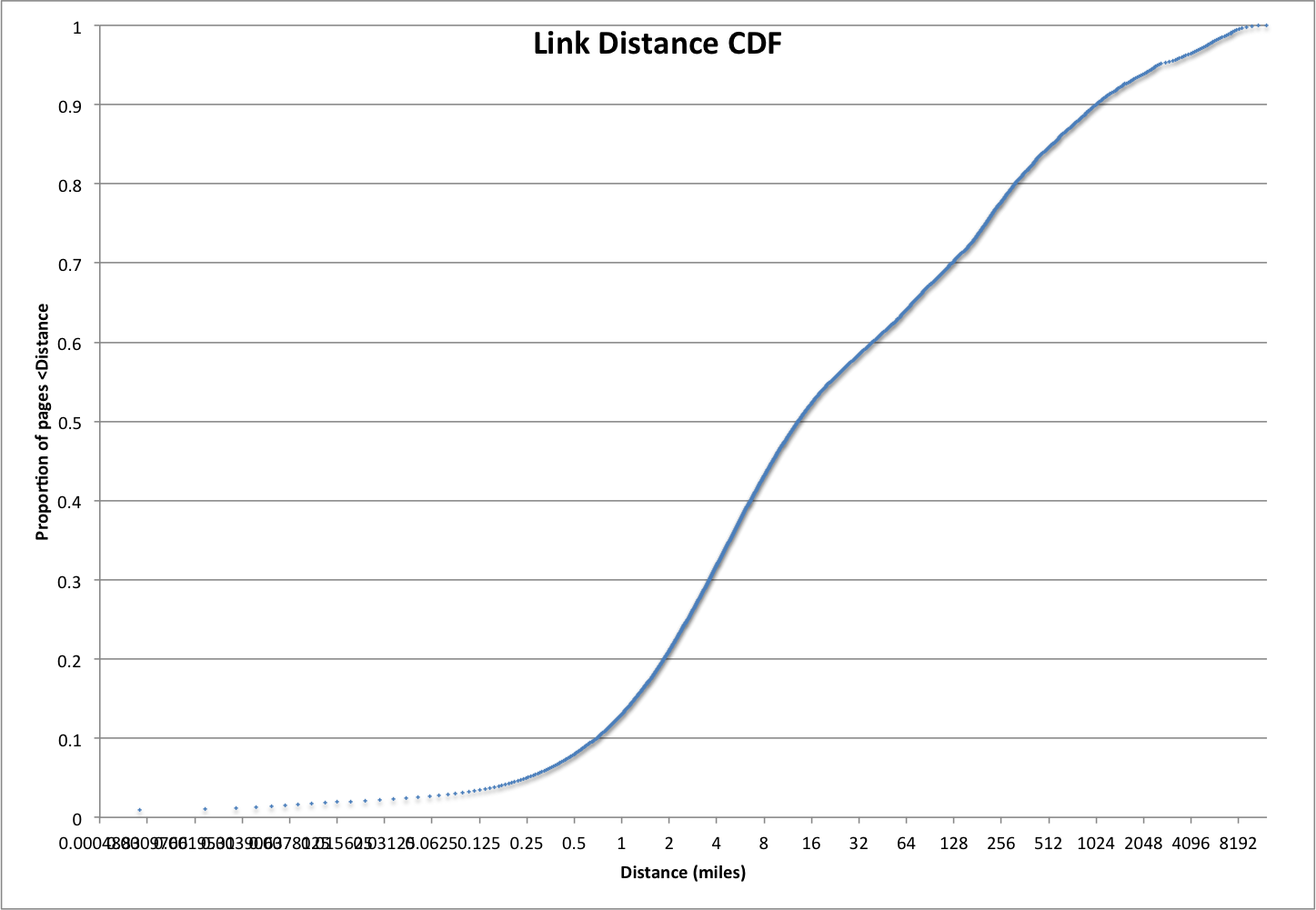
Notes:
Cause of first hump: intra city communication (<30 miles)
Cause of second hump: inter-city communication

Slide 12
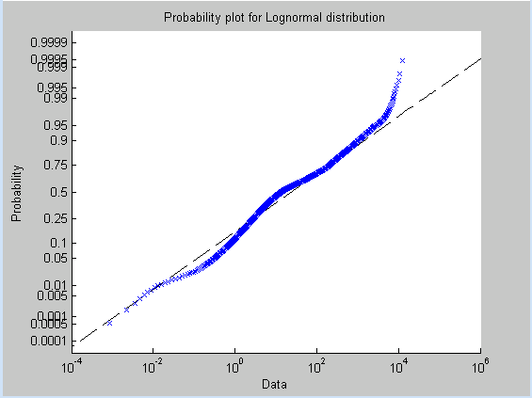
How to model? LogNormal?
Notes:
Tried weibull, exponential, lognormal, rayleigh

Slide 13
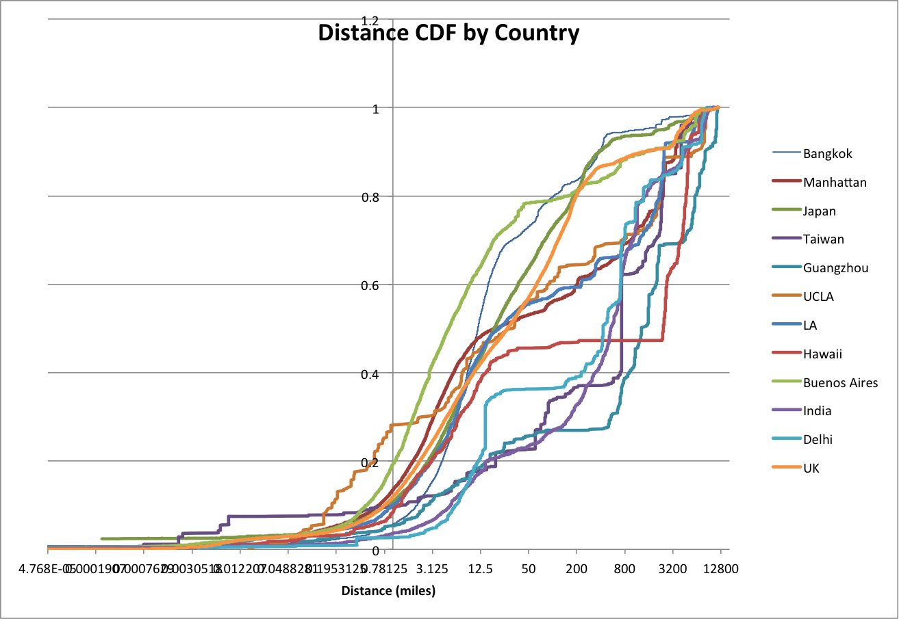
Notes:
ONLY consider Links originating from said country.
Spike right around 12 miles or so
Tried fitting lognormal curves to each and match by confidence interval → ends up splitting categories into three main groups

Slide 14
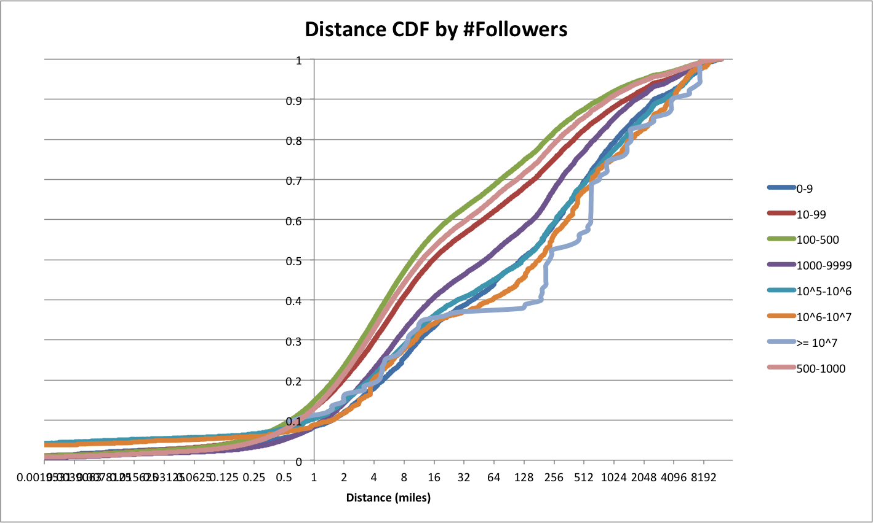
Notes:
103 Users w over 1M followers

Slide 15
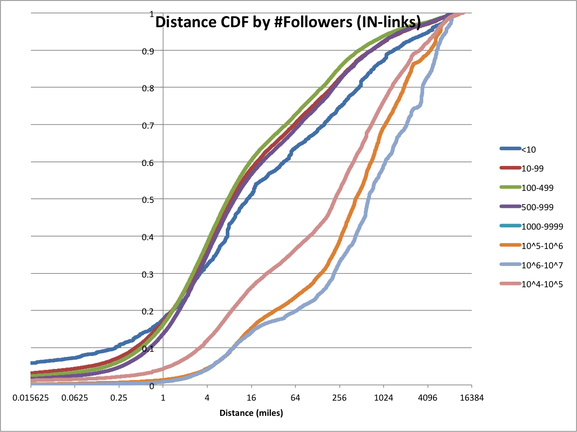

Slide 16
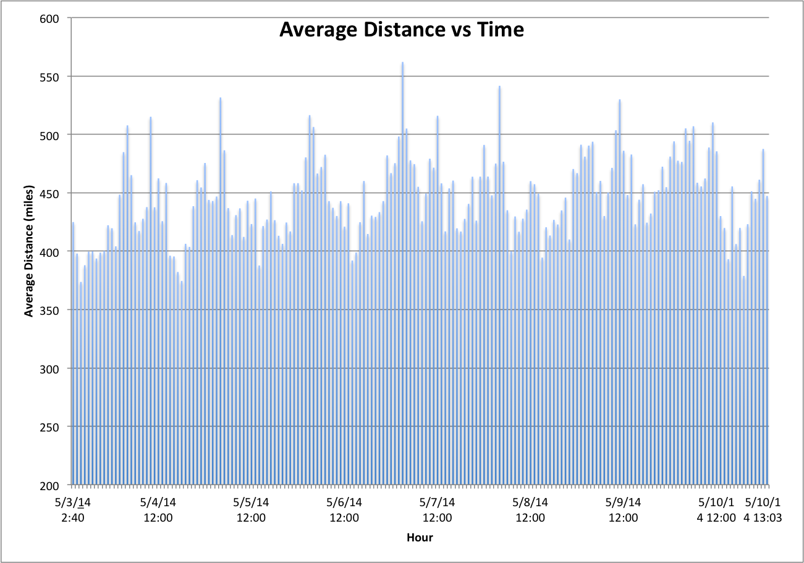

Slide 17
Observations
Scale is what makes web information management challenging
Queries/Excel end up taking very long
There are a number of twitter bots
Influences results
In-Degree / Out-Degree not applicable here
Would need to view evolution over time
Analysis showed a near power-law distribution ^{[4]}
Notes:
Bots: isomorphisms (antartica) and equivocagent (constantly moving)

Slide 18
Conclusions
User movement
Our assumption is not valid
People communicate long-distance at similar times
Potentially optimize resource allocation
Lognormal is best fit model for distance
Models break down at sub-continent level
More popular users communicate further
Notes:
Geographic level : water and friendly communicating countries

Slide 19
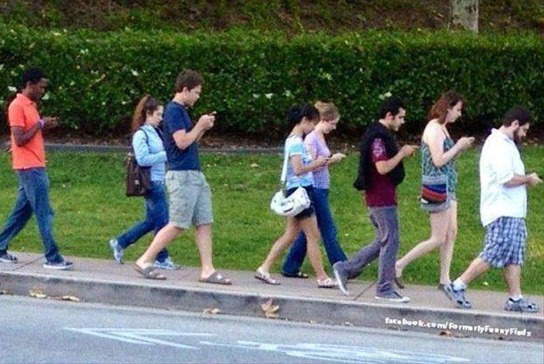
Future Work
Try to find SCC/IN/OUT
Classify by location(s)
Create physical graph

